Slide 1


The PiXL Club The PiXL Club The PiXL Club The PiXL Club The PiXL Club The PiXL Club The PiXL Club The PiXL Club The PiXL Club The PiXL Club The PiXL Club The PiXL Club The PiXL Club The PiXL Club The PiXL Club The PiXL Club The PiXL Club The PiXL Club The PiXL Club The PiXL Club The PiXL Club The PiXL Club The PiXL Club The PiXL Club The PiXL Club The PiXL Club The PiXL Club The PiXL Club The PiXL Club The PiXL Club The PiXL Club The PiXL Club The PiXL Club The PiXL Club The PiXL Club The PiXL Club The PiXL Club The PiXL Club The PiXL Club The PiXL Club The PiXL Club The PiXL Club The PiXL Club The PiXL Club The PiXL Club XL Club The PiXL Club The PiXL Club The PiXL Club The PiXL Club The PiXL Club The PiXL Club The PiXL Club The PiXL Club The PiXL Club The PiXL Club The PiXL Club The PiXL Club The PiXL Club The PiXL Club The PiXL Club The PiXL Club The PiXL Club The PiXL Club The PiXL Club The PiXL Club The PiXL Club The PiXL Club The PiXL Club The PiXL Club The PiXL Club The PiXL Club The PiXL Club The PiXL Club The PiXL Club The PiXL Club The PiXL Club The PiXL Club The PiXL Club The PiXL Club The PiXL Club The PiXL Club The PiXL Club The PiXL Club The PiXL Club The PiXL Club The PiXL Club The PiXL Club The PiXL Club The PiXL Club The PiXL Club The PiXL Club The PiXL Club The PiXL Club The PiXL Club The PiXL Club The PiXL Club The PiXL Club The PiXL Club The PiXL Club The PiXL Club The PiXL Club The PiXL Club The PiXL Club The PiXL Club The PiXL Club The PiXL Club The PiXL Club The PiXL Club The PiXL Club The PiXL Club The PiXL Club The PiXL Club The PiXL Club The PiXL Club The PiXL Club The PiXL Club The PiXL Club The PiXL Club The PiXL Club The PiXL Club The PiXL Club The PiXL Club The PiXL Club The PiXL Club The PiXL Club The PiXL Club The PiXL Club The PiXL Club The PiXL Club The PiXL Club The PiXL Club The PiXL Club The PiXL Club The PiXL Club The PiXL Club The PiXL Club The PiXL Club The PiXL Club The PiXL Club The PiXL Club The PiXL Club The PiXL Club The PiXL Club The PiXL Club The PiXL Club The PiXL Club The PiXL Club The PiXL Club The PiXL Club The PiXL Club The PiXL Club The PiXL Club The PiXL Club The PiXL Club The PiXL Club The PiXL Club The PiXL Club The PiXL Club The PiXL Club The PiXL Club The PiXL Club The PiXL Club The PiXL Club The PiXL Club The PiXL Club The PiXL Club The PiXL Club The PiXL Club The PiXL Club The PiXL Club The PiXL Club The PiXL Club The PiXL Club The PiXL Club The PiXL Club The PiXL Club The PiXL Club The PiXL Club The PiXL Club The PiXL Club The PiXL Club The PiXL Club The PiXL Club The PiXL Club The PiXL Club The PiXL Club The PiXL Club The PiXL Club The PiXL Club The PiXL Club The PiXL Club The PiXL Club The PiXL Club The PiXL Club The PiXL Club The PiXL Club The PiXL Club The PiXL Club The PiXL Club The PiXL Club The PiXL Club The PiXL Club The PiXL Club The PiXL Club The PiXL Club The PiXL Club The PiXL Club The PiXL Club The PiXL Club The PiXL Club The PiXL Club The PiXL Club The PiXL Club The PiXL Club The PiXL Club The PiXL Club The PiXL Club The PiXL Club The PiXL Club The PiXL Club The PiXL Club The PiXL Club The PiXL Club The PiXL Club The PiXL Club The PiXL Club The PiXL Club The PiXL Club The PiXL Club The PiXL Club The PiXL Club The PiXL Club The PiXL Club The PiXL Club The PiXL Club The PiXL Club The PiXL Club The PiXL Club The PiXL Club The PiXL Club The PiXL Club The PiXL Club The PiXL Club The PiXL Club The PiXL Club The PiXL Club The PiXL Club The PiXL Club The PiXL Club The PiXL Club The PiXL Club The PiXL Club The PiXL Club The PiXL Club The PiXL Club The PiXL Club The PiXL Club The PiXL Club The PiXL Club The PiXL Club The PiXL Club The PiXL Club The PiXL Club The PiXL Club The PiXL Club The PiXL Club The PiXL Club The PiXL Club The PiXL Club The PiXL Club The PiXL Club The PiXL Club The PiXL Club The PiXL Club The PiXL Club The PiXL Club The PiXL Club The PiXL Club The PiXL Club The PiXL Club The PiXL Club The PiXL Club The PiXL Club The PiXL Club The PiXL Club The PiXL Club The PiXL Club The PiXL Club The PiXL Club The PiXL Club The PiXL Club The PiXL Club The PiXL Club The PiXL Club The PiXL Club The PiXL Club The PiXL Club The PiXL Club The PiXL Club The PiXL Club The PiXL Club The PiXL Club The PiXL Club The PiXL Club The PiXL Club The PiXL Club The PiXL Club The PiXL Club The PiXL Club The PiXL Club The PiXL Club The PiXL Club The PiXL Club The PiXL Club The PiXL Club The PiXL Club The PiXL Club The PiXL Club The PiXL Club The PiXL Club The PiXL Club The PiXL Club The PiXL Club The PiXL Club The PiXL Club The PiXL Club The PiXL Club The PiXL Club The PiXL Club The PiXL Club The PiXL Club The PiXL Club The PiXL Club The PiXL Club The PiXL Club The PiXL Club The PiXL Club The PiXL Club The PiXL Club The PiXL Club The PiXL Club The PiXL Club The PiXL Club The PiXL Club The PiXL Club The PiXL Club The PiXL Club The PiXL Club The PiXL Club The PiXL Club The PiXL Club The PiXL Club The PiXL Club The PiXL Club The PiXL Club The PiXL Club The PiXL Club The PiXL Club The PiXL Club The PiXL Club The PiXL Club The PiXL Club The PiXL Club The PiXL Club The PiXL Club The PiXL Club The PiXL Club The PiXL Club The PiXL Club The PiXL Club The PiXL Club The PiXL Club The PiXL Club The PiXL Club The PiXL Club The PiXL Club The PiXL Club The PiXL Club The PiXL Club The PiXL Club The PiXL Club The PiXL Club The PiXL Club The PiXL Club The PiXL Club The PiXL Club The PiXL Club The PiXL Club The PiXL Club The PiXL Club The PiXL Club The PiXL Club The PiXL Club The PiXL Club The PiXL Club The PiXL Club The PiXL Club The PiXL Club The PiXL Club The PiXL Club The PiXL Club The PiXL Club The PiXL Club The PiXL Club The PiXL Club The PiXL Club The PiXL Club The PiXL Club The PiXL Club The PiXL Club The PiXL Club The PiXL Club The PiXL Club The PiXL Club The PiXL Club The PiXL Club The PiXL Club The PiXL Club The PiXL Club The PiXL Club The PiXL Club The PiXL Club The PiXL Club The PiXL Club The PiXL Club The PiXL Club The PiXL Club The PiXL Club The PiXL Club The PiXL Club The PiXL Club The PiXL Club The PiXL Club The PiXL Club The PiXL Club The PiXL Club The PiXL Club The PiXL Club The PiXL Club The PiXL Club The PiXL Club The PiXL Club The PiXL Club The PiXL Club The PiXL Club The PiXL Club The PiXL Club The PiXL Club The PiXL Club The PiXL Club The PiXL Club The PiXL Club The PiXL Club The PiXL Club The PiXL Club The PiXL Club The PiXL Club The PiXL Club The PiXL Club The PiXL Club The PiXL Club The PiXL Club The PiXL Club The PiXL Club The PiXL Club The PiXL Club The PiXL Club The PiXL Club The PiXL Club The PiXL Club The PiXL Club The PiXL Club The PiXL Club The PiXL Club The PiXL Club The PiXL Club The PiXL Club The PiXL Club The PiXL Club The PiXL Club The PiXL Club The PiXL Club The PiXL Club The PiXL Club The PiXL Club The PiXL Club The PiXL Club The PiXL Club The PiXL Club The PiXL Club The PiXL Club The PiXL Club The PiXL Club The PiXL Club The PiXL Club The PiXL Club The PiXL Club The PiXL Club The PiXL Club The PiXL Club The PiXL Club The PiXL Club The PiXL Club The PiXL Club The PiXL Club The PiXL Club The PiXL Club The PiXL Club The PiXL Club The PiXL Club The PiXL Club The PiXL Club The PiXL Club The PiXL Club The PiXL Club The PiXL Club The PiXL Club The PiXL Club The PiXL Club The PiXL Club The PiXL Club The PiXL Club The PiXL Club The PiXL Club The PiXL Club The PiXL Club The PiXL Club The PiXL Club The PiXL Club The PiXL Club The PiXL Club The PiXL Club The PiXL Club The PiXL Club The PiXL Club The PiXL Club The PiXL Club The PiXL Club The PiXL Club The PiXL Club The PiXL Club The PiXL Club The PiXL Club The PiXL Club The PiXL Club The PiXL Club The PiXL Club The PiXL Club The PiXL Club The PiXL Club The PiXL Club The PiXL Club The PiXL Club The PiXL Club The PiXL Club The PiXL Club The PiXL Club The PiXL Club The PiXL Club The PiXL Club The PiXL Club The PiXL Club The PiXL Club The PiXL Club The PiXL Club The PiXL Club The PiXL Club The PiXL Club The PiXL Club The PiXL Club The PiXL Club The PiXL Club The PiXL Club The PiXL Club The PiXL Club The PiXL Club The PiXL Club The PiXL Club The PiXL Club The PiXL Club The PiXL Club The PiXL Club The PiXL Club The PiXL Club The PiXL Club The PiXL Club The PiXL Club The PiXL Club The PiXL Club The PiXL Club The PiXL Club The PiXL Club The PiXL Club The PiXL Club The PiXL Club The PiXL Club The PiXL Club The PiXL Club The PiXL Club The PiXL Club The PiXL Club The PiXL Club The PiXL Club The PiXL Club The PiXL Club The PiXL Club The PiXL Club The PiXL Club The PiXL Club The PiXL Club The PiXL Club The PiXL Club The PiXL Club The PiXL Club The PiXL Club The PiXL Club The PiXL Club The PiXL Club The PiXL Club The PiXL Club The PiXL Club The PiXL Club The PiXL Club The PiXL Club The PiXL Club The PiXL Club The PiXL Club The PiXL Club The PiXL Club The PiXL Club The PiXL Club The PiXL Club The PiXL Club The PiXL Club The PiXL Club The PiXL Club The PiXL Club The PiXL Club The PiXL Club The PiXL Club The PiXL Club The PiXL Club The PiXL Club The PiXL Club The PiXL Club The PiXL Club The PiXL Club The PiXL Club The PiXL Club The PiXL Club The PiXL Club The PiXL Club The PiXL Club The PiXL Club The PiXL Club The PiXL Club The PiXL Club The PiXL Club The PiXL Club The PiXL Club The PiXL Club The PiXL Club The PiXL Club The PiXL Club The PiXL Club The PiXL Club The PiXL Club The PiXL Club The PiXL Club The PiXL Club The PiXL Club The PiXL Club The PiXL Club The PiXL Club The PiXL Club The PiXL Club The PiXL Club The PiXL Club The PiXL Club The PiXL Club The PiXL Club The PiXL Club The PiXL Club The PiXL Club The PiXL Club The PiXL Club The PiXL Club The PiXL Club The PiXL Club The PiXL Club The PiXL Club The PiXL Club The PiXL Club The PiXL Club The PiXL Club The PiXL Club The PiXL Club The PiXL Club The PiXL Club The PiXL Club The PiXL Club The PiXL Club The PiXL Club The PiXL Club The PiXL Club The PiXL Club The PiXL Club The PiXL Club The PiXL Club The PiXL Club The PiXL Club The PiXL Club The PiXL Club The PiXL Club The PiXL Club The PiXL Club The PiXL Club The PiXL Club The PiXL Club The PiXL Club The PiXL Club The PiXL Club The PiXL Club The PiXL Club The PiXL Club The PiXL Club The PiXL Club The PiXL Club The PiXL Club The PiXL Club The PiXL Club The PiXL Club The PiXL Club The PiXL Club The PiXL Club The PiXL Club The PiXL Club The PiXL Club The PiXL Club The PiXL Club The PiXL Club The PiXL Club The PiXL Club The PiXL Club The PiXL Club
PiXL KnowIT!
GCSE Physics
AQA Topic – Energy
© Copyright The PiXL Club Ltd, 2017
This resource is strictly for the use of member schools for as long as they remain members of The PiXL Club. It may not be copied, sold nor transferred to a third party or used by the school after membership ceases. Until such time it may be freely used within the member school.
All opinions and contributions are those of the authors. The contents of this resource are not connected with nor endorsed by any other company, organisation or institution.
www.pixl.org.uk The PiXL Club Ltd, Company number 07321607

Slide 2

Overview
Energy
Energy changes and energy stores
  Energy stores and systems
  Changes in energy
  Energy changes in systems
  Power
Conservation and dissipation of energy
  Energy transfers in a system
  Efficiency
Energy resources
  Renewable and non renewable energy resources
  Environmental impact of energy resources
  Patterns and trends in the use of energy resources

Slide 3
LearnIT!
KnowIT!
Energy changes and
energy stores
Part 1
Energy stores and systems
Changes in energy

Slide 4
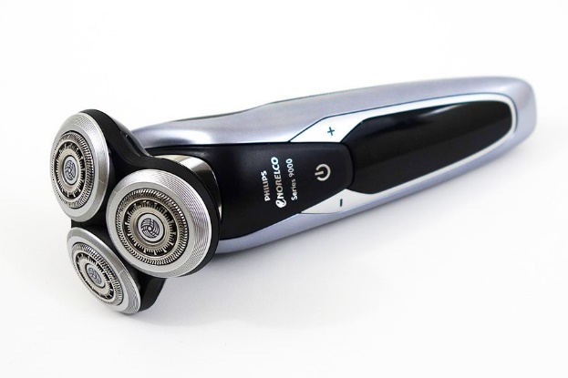
  Energy stores and systems
An energy system is a group of objects that have the ability to do work.
Remember: energy can not be created or destroyed so when work is done, energy from one store is carried along a pathway to another energy store.
Consider the energy flow diagram for an electric shaver.
The battery has a store of chemical energy.
The current flows through an electrical pathway to the motor.
Energy from the motor follows a mechanical pathway to a kinetic store of the moving blades, a heat pathway to a thermal store and a radiation pathway to a sound store.
mechanical Kinetic
electrical
Chemical heat Thermal
radiation Sound
Motor

Slide 5
  Energy stores and systems
Energy stores | Examples
Chemical | In food, fuel and electric batteries
Kinetic | In moving objects
Gravitational potential | In objects raised above a planets surface
Elastic potential | In a stretched, compressed or twisted object
Internal (thermal) | In any heated object
Magnetic | In any object with a magnetic field
Electrostatic | In electrostatic forces between charges
Nuclear | The forces acting between atomic nuclei
Force pathways include: Mechanically – when a force acts and an object moves Electrically – when an electric current flows Heating – a temperature difference between objects Radiation – electromagnetic waves or sound

Slide 6

  Energy stores and systems
Examples of energy changes in a system:
An object thrown (projected) upwards e.g. You throw a tennis ball upwards.
A moving object hitting an obstacle e.g. A bowling ball hitting a pin
As the ball leaves your hand it has a store of kinetic energy.
At its highest point it has a store of gravitational potential energy (G.P.E).
As you are about to catch it just before it hits your hand it has a
store of kinetic energy.
As you move the muscles of your arm to throw the ball the chemical energy store in your muscles decreases and the kinetic energy store of the bowling ball increases.
At the ball hits a pin some of the kinetic energy has been transferred to a store of internal (thermal) energy this causes the ball and its surroundings to warm up a little.
You will hear a sound when the ball hits the pin, the energy of the sound is also transferred to the internal energy store of the surroundings.

Slide 7
  Energy stores and systems
Examples of energy changes in a system:
A vehicle slowing down e.g. When you apply the brakes in a lorry
Bringing water to a boil on a camping stove.
The moving lorry has a store of kinetic energy.
At the brakes are applied the kinetic energy store decreases the energy is transferred to the internal (thermal) energy store in the brakes and the brakes get hot.
You will hear a sound when the brakes of the lorry are applied, the energy of the sound is also transferred to the internal energy store of the surroundings.
When the lorry stops its kinetic energy store is zero.
As the fuel burns the chemical energy store in the fuel decreases and the internal (thermal) energy store of the water increases.
The temperature of the water increases and as bubbles form the kinetic energy store of the water increases.
Energy is measured in Joules (J)
1 kilojoule (kJ) = 1000 J (10³J) 1 megajoule = 1000 000 J (10⁶J)

Slide 8

  Energy stores and systems
Energy change – mechanical work is the amount of energy transferred by a force
When a pushback truck is used to move an aircraft, it does work.
Work (J) = Force (N) x Distance (along the line of the force) (m).
W = F s
If the aircraft has a mass of 30 000kg and it is moved a distance of 20m, calculate the work done by the pushback truck.
Force (weight) = mass x gravitational field strength
Force = 30 000 x 10 = 300 000 N
W = F s
Work = 300 000 x 20 = 6 000 000 J (6 MJ)

Slide 9

  Energy stores and systems
Energy change – Electrical work is done when charge flows in a circuit is the amount of energy transferred.
When a current flows through a circuit, work is done (energy is transferred) and the energy store changes.
Energy transferred (Work) (J) = Charge flow (Q) x Potential difference (V)
E = Q V
In one minute, 30 Coulombs of charge flows through the bulb when a potential difference of 3 V is placed across it. Calculate the work done (energy transferred).
E = Q V
E = 3 x 30
Energy transferred (Work) = 90 J

Slide 10
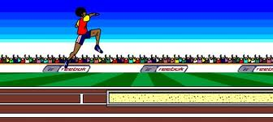

Changes in Energy - Kinetic Energy
Moving objects have kinetic energy.
The long-jumper is using her kinetic energy to
carry her body as far as possible. The more
kinetic energy she has, the longer her jump will
be. Her kinetic energy depends on her mass
(which she can not change) and her velocity (she can run faster!).
The kinetic energy of a moving object can be calculated using the equation:
Kinetic energy (J) = 0.5 × Mass (kg)× Speed² (m/s)
E_{k} = $½$ m v²
If her mass is 46 kg and she is travelling at 8 m/s, her kinetic energy during her jump will be:
E_{k} = ½ m v²
E_{k} = ½ x 46 x 8²
The energy transferred in the jump is: E_{k} = 1472 J

Slide 11
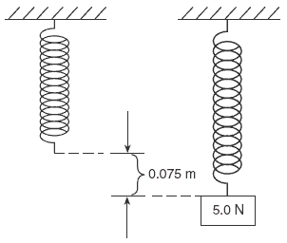
Changes in Energy - Elastic Energy
Stretched or bent objects have elastic energy (E_{e}) if they have the ability to recover to their original shape and dimensions.
When a weight (force) is added to a spring it
extends (gets longer).
The spring now has a store of elastic potential
energy which will be released if the weight is removed.
The amount of stored elastic energy (E_{e}) can be calculated using the following equation:
Elastic potential energy (J) = 0.5 × Spring constant (N/m) × Extension² (m)
E_{e} = ½ k e²
In the above example the spring has a spring constant of 670 N/m. The elastic potential energy of the spring when a 50 N load is hung from it is:
E_{e} = ½ k e²
E_{e} = 0.5 x 670 x 0.075²
The elastic energy stored in the spring is: E_{e} = 1.88 J

Slide 12

Changes in Energy – Gravitational potential energy
When an object is raised above ground level it gains gravitational potential energy (GPE). This stored energy can be released if the object is allowed to fall.
A pile driver is a machine that lifts a heavy weight then drops it on a post to drive it into the ground.
The amount of gravitational potential energy (G.P.E) gained by an object raised above ground level can be calculated using the equation:
G.P.E (J) = Mass (kg) × Gravitational field strength (N/kg) × Height (m)
E_{p} = m g h
The pile driver hammer has a mass of 120 kg and it is raised to a height of 4 m above the ground. How much G.P.E will it have?
E_{p} = m g h
E_{p} = 120 x 10 x 4
The G.P.E gained is: E_{p} = 4800 J

Slide 13
QuestionIT!
Energy changes and
energy stores
Part 1
Energy stores and systems
Changes in energy

Slide 14
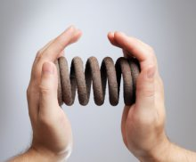
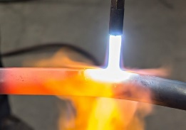

  Energy stores and Energy systems part 1– AnswerIT
What sort of energy store do the following examples have?
a. b. c.
2. Write down the correct answer to complete the statement.
Energy can not…
be transferred from one source to another.
be created or destroyed.
travel along a pathway to another store.
3. A basketball player throws the ball into the hoop. Describe the
energy store change which has taken place.

Slide 15
  Energy stores and Energy systems part 1– QuestionIT
4. Copy and Complete the energy store and pathway diagrams for the objects described.
a. A moving car braking to a stop.
CAR
b. Bringing water to the boil on a gas hob.

Slide 16
  Energy stores and Energy systems part 1 – QuestionIT
5. Describes the main change in energy stores for a coal fired power station.
a. Name the energy sources for:
i Input energy
ii Useful output energy
iii Wasted output energy.
b. In one hour, coal supplies 500 000 J of energy. The wasted energy
amounts to 380 000 J.
  Calculate how much useful energy is produced in one hour.

Slide 17
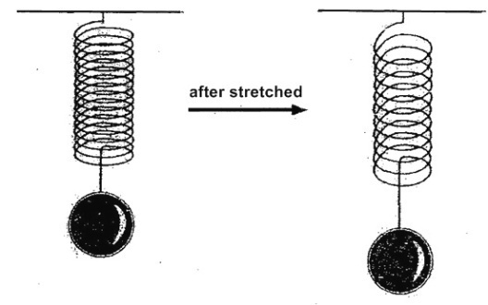
  Energy stores and Energy systems part 1 – QuestionIT
6. When a football is kicked it gains kinetic energy.
a. What is the formula used to calculate kinetic energy?
b. The football has a mass of 0.4 kg. When the football is kicked, it
has a velocity of 15 m/s.
Calculate the kinetic energy of the moving football?
7. The un-stretched spring opposite has a length
of 0.5 m but after a mass is added it is 0.6 m long.
If the spring constant is 800 N/m.
Calculate the stored elastic potential energy.
E_{e} = ½ k e²

Slide 18

  Energy stores and Energy systems part 1 – QuestionIT
8. A pole vaulter just clears the bar which is 5.1 m high. His mass is
62 kg. (g = 10N/kg)
a. What type of stored energy does he have
as he just clears the bar?
b. Work out how much stored energy the
pole vaulter has due to his position
above the ground.
c. As he falls back to the ground, this energy store will be
transferred into a new energy store. Name this new energy store.
d. When he lands, what happens to the energy stores described
above?

Slide 19

AnswerIT!
Energy changes and
energy stores
Part 1
Energy stores and systems
Changes in energy

Slide 20

  Energy stores and Energy systems part 1– AnswerIT
What sort of energy store do the following examples have?
a. b. c.
Chemical Elastic potential Thermal
2. Write down the correct answer to complete the statement.
Energy can not…..
be transferred from one source to another.
be created or destroyed.
travel along a pathway to another store.
3. A basketball player throws the ball into the hoop. Describe the
change in energy store that has taken place as the ball
Kinetic Gravitational

Slide 21
  Energy stores and Energy systems part 1– QuestionIT
4. Copy and Complete the energy store and pathway diagrams for the objects described.
a. A moving car braking to a stop.
CAR i Kinetic ii Mechanical iii Thermal
b. Bringing water to the boil on a gas hob.
i Chemical GAS HOB ii Heating iii Thermal

Slide 22
  Energy stores and Energy systems part 1 – QuestionIT
5. Describes the main change in energy stores for a coal fired power station.
a. Name the energy sources for:
i Input energy Chemical (Coal)
ii Useful output energy Electrostatic (Electric current)
iii Wasted output energy. Thermal (Waste heat)
b. In one hour, coal supplies 500 000 J of energy. The wasted energy
amounts to 380 000 J.
Calculate how much useful energy is
produced in one hour.
500 000 – 380 000 = 120 000 J

Slide 23
  Energy stores and Energy systems part 1 – QuestionIT
6. When a football is kicked it gains kinetic energy.
a. What is the formula used to calculate kinetic energy?
E_{k} = ½ m v²
b. The football has a mass of 0.4 kg and when kicked has a velocity
of 15 m/s. Work out the kinetic energy of the moving ball?
E_{k} = ½ x 0.4 x 15²
E_{k} = 45 J
7. The un-stretched spring opposite has a length
of 0.5m but after a mass is added it is 0.6 m long.
If the spring constant is 800 N/m.
Calculate the stored elastic potential energy.
E_{e} = ½ k e²
extension of spring = 0.6 – 0.5 = 0.1 m
E_{e} = ½ x 800 x 0.1²
Stored elastic potential energy of the spring = 4 J

Slide 24
  Energy stores and Energy systems part 1 – QuestionIT
8. The pole vaulter just clears the bar which is 5.1 m high. His mass is
62 kg. (g = 10N/kg)
a. What type of stored energy does he have
as he clears the bar?
gravitational potential energy
b. Work out how much stored energy the
pole vaulter has due to his position
above the ground.
GPE = m g h = 62 x 10 x 5.1 = 3162 J
c. As he falls back to the ground, this energy store will be
transferred into a new energy store. Name this new energy store.
kinetic energy
d. When he lands, what happens to the energy stores described
above?
dissipated as heat and sound

Slide 25
LearnIT!
KnowIT!
Energy changes and energy stores
Part 2
Energy changes in systems
Power

Slide 26
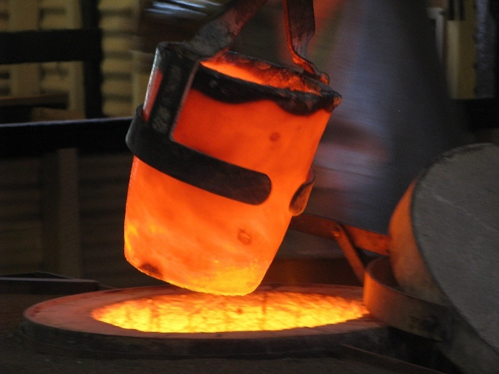
  Energy changes in systems
The thermal (internal) energy store in a system changes if its temperature changes.
When metal is heated in a furnace the thermal
energy store increases. The amount of energy gained
depends on the mass of the metal, how much the
temperature increases and the specific heat capacity
of the metal.
Specific Heat Capacity ( c ) – the amount of energy required to raise the temperature of 1 kg of a substance by one degree Celsius.
Steel has a specific heat capacity of 450 J/kg ºC
Therefore a 1 kg block of steel needs 450 J of thermal energy adding to it to raise the temperature from 20 ºC to 21 ºC (1 ºC rise).

Slide 27
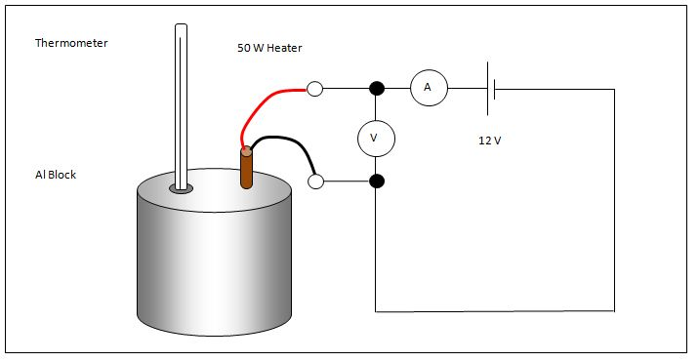
  Energy changes in systems and power
Specific heat capacity
The apparatus shown can be used to
determine the specific heat capacity of
aluminium.
Example: When the heater was left on for 5 mins, the heater supplied 10 800 J of thermal energy to the aluminium block.
The temperature of the 2 kg block of aluminium rose by 6 ºC.
The amount of energy stored in or released from a system as its
temperature changes can be calculated using the equation:
Change in thermal energy (J) = Mass (kg) x Specific Heat Capacity J/kgºC x Temperature Change (ºC)
ΔE = m x c x Δθ rearrange to give c = ΔE / m x Δθ
c = 10 800 / 2 x 6 Specific heat capacity of aluminium = 900 J/kg ºC

Slide 28

Power
Power - the rate at which energy is transferred
the rate at which work is done (rate means “how quickly”)
Power is measured in Joules / second 1 J/s = 1 Watt
An object which transfers energy does so at a certain rate.
The metal filament in this light bulb transfers the
electrical energy store into heat and light.
This bulb transfers 2400 joules of energy in 60 seconds.
Power can be calculated using the following equation:
Power (W) = Energy transferred (J)
P = E
Time (s)
P= 2400 / 60 = 40 J/s
So this is a 40 Watt light bulb.
t

Slide 29
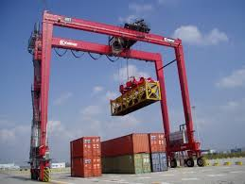
Power
Power - the rate at which energy is transferred
the rate at which work is done (rate means “how quickly”)
Mechanical power
Power = work done / time
The crane lifts the 2000 kg container through a height of 5.4m in 30s.
The power of the crane is:
Power = Work / time But: Work = force x distance
= 20 000 N x 5.4 m = 108 000 J
Power = 108 000 J / 30 s
The Power of the crane is 3600 J/s or 3600 Watts

Slide 30
QuestionIT!
Energy changes and energy stores
Part 2
Energy changes in systems
Power

Slide 31
  Energy stores and Energy systems part 2 – QuestionIT
The specific heat capacity of a substance is…......
  the ability of a 1 kg object to store transferred energy
  the total amount of stored energy in an object
  the energy needed to raise the temperature of 1 kg of a substance by 1 ºC.
When a bowl of water and a stone are left in hot sunshine, the stone feels much hotter than the water. Which one has the highest specific heat capacity? Explain your answer.
3. Give two alternative units of power?

Slide 32
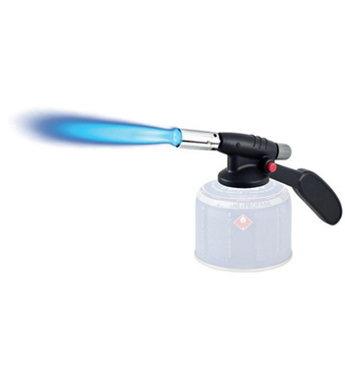
  Energy stores and Energy systems part 2 – QuestionIT
4. A blowtorch burns butane gas to heat metal pipes.
a. Describe the energy transfers which occur as it is used.
energy is transferred into
energy usefully and
energy is wasted.
b. Explain how some of the transferred energy
is wasted.
c. The blowtorch transfers 2 kJ of energy in 4 mins. Work out the
power of the blowtorch?

Slide 33
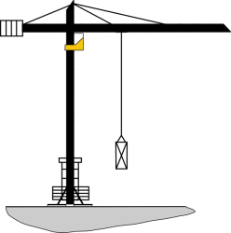
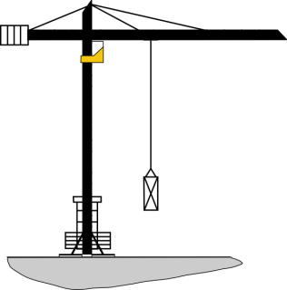
  Energy stores and Energy systems part 2 – QuestionIT
5. Two cranes are lifting the same load of 120 kg to a height of 15 m.
Crane A
Crane B
Crane A takes 30 s to lift the load. Crane B lifts the same load in 9 s.
Calculate the difference in power of the two cranes.

Slide 34
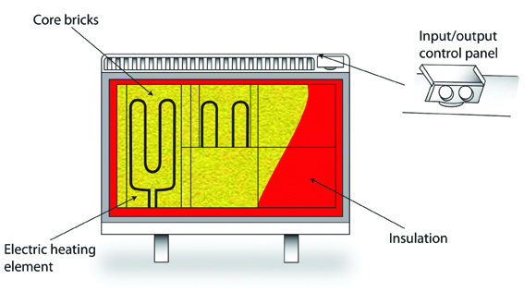
  Energy stores and Energy systems part 2 – QuestionIT
6. Storage heaters contain bricks which
warm up and store the heat energy.
The bricks in this heater have a mass of
40 kg and are heated from 18 ºC to 40 ºC.
If the specific heat capacity of the brick
material is 850 J/kg ºC.
Calculate the change in thermal energy during heating.
Change in thermal energy = Mass x Specific Heat Capacity x Temperature Change
ΔE = m x c x Δθ

Slide 35
AnswerIT!
Energy changes and energy stores
Part 2
Energy changes in systems
Power

Slide 36
  Energy stores and Energy systems part 2 – AnswerIT
The specific heat capacity of a substance is …........
  the ability of a 1kg object to store transferred energy
  the total amount of stored energy in an object
  the energy needed to raise the temperature of 1kg of a substance by 1ºC
When a bowl of water and a stone are left in hot sunshine, the stone feels much hotter than the water. Which one has the highest specific heat capacity? Explain your answer.
The water has a higher heat capacity as it takes more heat energy to
raise its temperature to that of the stone
3. Give two alternative units of power?
Joules/second or Watts

Slide 37
  Energy stores and Energy systems part 2 – AnswerIT
4. A blowtorch burns butane gas to heat metal pipes.
a. Describe the energy transfers which occur as it is used.
Chemical energy is transferred into
thermal energy usefully and
light energy is wasted.
b. Explain how some of the transferred energy
is wasted.
As thermal energy to the environment
c. The blowtorch transfers 2 kJ of energy in 4 mins. Work out the
power of the blowtorch?
Power = energy transferred / time = 2000 / 240
Power of the blowtorch = 8.33Watts

Slide 38
  Energy stores and Energy systems part 2 – AnswerIT
5. Two cranes are lifting the same load of 120 kg to a height of 15 m.
Crane A
Crane B
Crane A takes 30 s to lift the load. Crane B lifts the same load in 9 s.
Calculate the difference in power of the two cranes.
Crane A power = 1200 x 15 / 30 = 600 W
Crane B power = 1200 x 15 / 9 = 2000W
Difference in power = 2000 – 600 = 1400 Watts

Slide 39
  Energy stores and Energy systems part 2 – AnswerIT
6. Storage heaters contain bricks which
warm up and store heat energy.
The bricks in this heater have a mass of
40 kg and are heated from 18 ºC to 40 ºC.
If the specific heat capacity of the brick
material is 850 J/kg ºC, calculate the
change in thermal energy during heating.
temperature change Δθ = 40 – 18 = 22 ºC
change in thermal energy ΔE = 40 x 850 x 22
ΔE = 748 000 J or 748 kJ
Change in thermal energy = Mass x Specific Heat Capacity x Temperature Change
ΔE = m x c x Δθ

Slide 40
LearnIT!
KnowIT!
Conservation and
Dissipation of
Energy
  Energy transfers in a system
  Efficiency

Slide 41
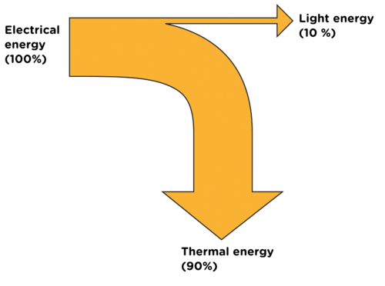
  Energy transfers in a system
Energy can be stored, transferred or dissipated - but can not be created or destroyed.
In a closed energy system there can be transfer of energy but not mass. There is no change to the total energy in the system.
No mass change
In a closed energy system all the energy can be accounted for even when energy stores change.
Closed
Energy
system
E in
E out
The diagram shows the energy transfer for a light
bulb. All the electrical energy store can be accounted
for as light energy and thermal energy.
The thermal energy is not useful in this case and can be
considered to be dissipated or “waste” energy.

Slide 42

  Energy transfers in a system
Unwanted energy transfers result in energy stores that are not useful.
The F1 car below shows that eventually all the chemical energy (fuel) put in the car ends up as unwanted thermal energy which is dissipated to the surroundings. Unwanted energy is often described as being ‘wasted’
Kinetic energy is dissipated by the tyres, brakes and air resistance to become unwanted thermal energy stores.
Sound energy is absorbed by materials and becomes thermal energy.
Thermal energy is produced by the engine as fuel is burnt.
Oil is used in the engine, gearbox and other moving parts as a lubricant to reduce friction and reduce unwanted thermal energy in these parts.
Kinetic
Thermal
Chemical
Sound
Thermal
Thermal

Slide 43
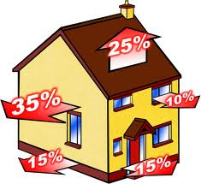
  Energy transfers in a system
Thermal insulation is often used to reduce unwanted energy transfers.
All the energy used to heat a home is eventually transferred as thermal energy to the surroundings.
The diagram, shows the percentage energy lost through different parts of the building.
Material | Thermal Conductivity W/m C
Air | 0.03
Polyurethane foam | 0.03
Fibreglass | 0.04
Wool felt | 0.05
Wood | 0.15
Plaster | 0.50
Glass | 0.80
Brick | 1.00
Concrete | 1.04
The higher the thermal conductivity, the quicker heat is transferred through the material.
Houses are often built from brick, concrete, wood and glass. All have quite high thermal conductivity values. Insulation uses materials with low thermal conductivity, such as fibreglass in the loft, foam in wall cavities and trapped gases in double glazing.

Slide 44
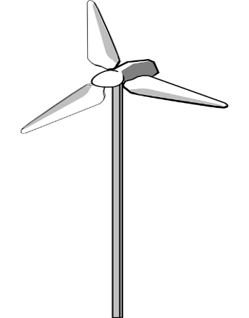
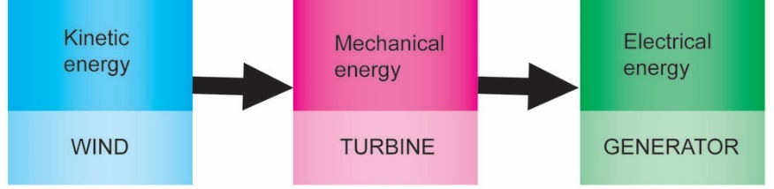
  Efficiency
The amount of useful energy you get from an energy transfer, compared to the energy put in, is called the EFFICIENCY
Efficiency = useful output energy transfer total input energy transfer
This calculation will result in a decimal value which can be multiplied by 100 to give a percentage efficiency.
A wind turbine energy transfer
The wind turbine produces 120 MW of electrical energy for every 500 MW of kinetic energy provided by the wind.
Efficiency = Useful output energy transfer
total input energy transfer
= 120 = 0.24 efficient
500
or 0.24 x 100 = 24 % efficient

Slide 45
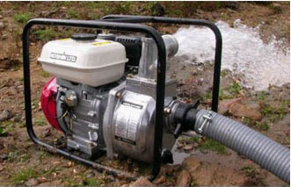
  Efficiency
Efficiency can also be calculated from the power transferred.
Efficiency = useful power output
total power input
Remember that power is the time it takes to do work.
Work = Force x distance
A water pump lifting water
The 300 W water pump raises 200 kg of water to a height of 2 m in one minute.
The efficiency of the pump is:
Efficiency = useful power output
total power input
Power in = 300 W
Power out = 2000 N x 2 m = 66.7 W
60
Efficiency = 66.7 x 100 = 22.2 %
300

Slide 46
QuestionIT!
Conservation and
Dissipation of
Energy
  Energy transfers in a system
  Efficiency

Slide 47
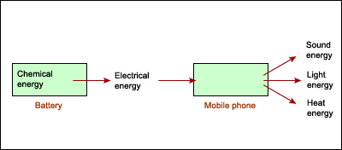
  Conservation and Dissipation of Energy - QuestionIT
In a “closed” system …..........
  energy can be transferred but there is no net energy loss.
  energy and mass are transferred in and out of the system.
  energy cannot be transferred between different energy stores.
2. The energy transfer diagram for a mobile phone shows that 100 J of electrical energy produces 45 J of light energy and 36 J of sound energy.
How much thermal energy will be dissipated by the phone?

Slide 48
  Conservation and Dissipation of Energy - QuestionIT
3. Describe how the thermal energy produced by a bus driving along a road is dissipated.
4. a. The diagram shows the main energy transfers for an electric fan. Complete boxes A to D showing the energy stores involved. Use the size of the arrows to help you.
B
A
C
D
b. State why the total energy supplied an electric fan must always equal the total energy transferred by the electric fan.

Slide 49
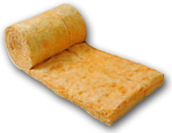
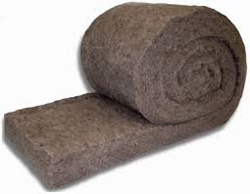
  Conservation and Dissipation of Energy - QuestionIT
5. a. The diagrams show two different types of loft insulation.
Fiberglass insulation Wool insulation
The wool needs to be thicker to have the same insulating properties. Explain which material has the highest thermal conductivity?
b. Explain how trapped air reduces the rate of heat loss, in terms of thermal conductivity.

Slide 50
  Conservation and Dissipation of Energy - QuestionIT
6. The diagram represents the energy store transfers when a motor is lifting a weight.
How much electrical energy is transferred to a thermal energy store?
b. What is the total amount of dissipated energy?
c. Calculate the efficiency the of the useful energy transfer
Electrical energy 340 J
Gravitational potential energy 100 J
Thermal?
Sound 80 J

Slide 51
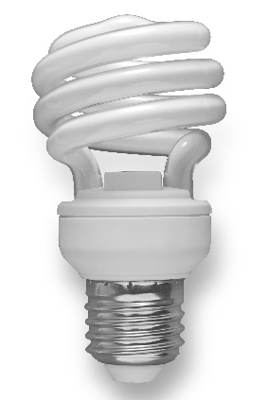
  Conservation and Dissipation of Energy - QuestionIT
7. The motor for a lift in a tall building uses 12 000 W of power. The lift and its passengers has a mass of 500 kg. The lift motor takes 10 s to raise the lift and its passengers through a height of 20 m.
Work out the percentage efficiency of the lift motor.
8. The low energy bulb below uses 18 000 J of energy in one hour. If the efficiency of the low energy bulb is 78 %.
Work out the amount of light energy given off by the bulb
in one hour.

Slide 52
AnswerIT!
Conservation and
Dissipation of
Energy
  Energy transfers in a system
  Efficiency

Slide 53
  Conservation and Dissipation of Energy - AnswerIT
In a “closed” system …..........
  energy can be transferred but there is no net energy loss.
  energy and mass are transferred in and out of the system.
  energy cannot be transferred between different energy stores.
2. The energy transfer diagram for a mobile phone shows that 100 J of electrical energy produces 45 J of light energy and 36 J of sound energy.
How much thermal energy will be dissipated by the phone?
45 J + 36 J = 81 J
100 J – 81 J = 19 J
19 J of thermal energy will be dissipated

Slide 54
  Conservation and Dissipation of Energy - AnswerIT
3. Describe how the thermal energy produced by a bus driving along a road is dissipated.
The thermal energy increases the kinetic energy of the air particles therefore warming up the surroundings.
4. a. The diagram shows the main energy transfers for an electric fan. Complete boxes A to D showing the energy stores involved. Use the size of the arrows to help you.
B
A - Electrical energy
B - Thermal energy
C - Kinetic energy
D - Sound energy
A
C
D
b. State why the total energy supplied to an electric fan must always equal the total energy transferred by the electric fan.
Energy can not be created or destroyed so:
total energy in = total energy out

Slide 55
  Conservation and Dissipation of Energy - AnswerIT
5. a. The diagrams show two different types of loft insulation.
Fiberglass insulation Wool insulation
The wool needs to be thicker to have the same insulating properties. Explain which material has the highest thermal conductivity?
Wool has the highest thermal conductivity as it lets thermal energy through at a faster rate so a thicker layer is needed for the same insulation as the fiberglass.
b. Explain how trapped air reduces the rate of heat loss, in terms of thermal conductivity.
The air trapped inside the fiberglass acts as an insulator because air has a very low thermal conductivity and thermal energy can not pass through it easily.

Slide 56
  Conservation and Dissipation of Energy - AnswerIT
6. The diagram represents the energy store transfers when a motor is lifting a weight.
How much electrical energy is transferred to a thermal energy store?
340 – (100 + 80) = 160 J
What is the total amount of dissipated energy?
160 + 80 = 240 J
c. Calculate the efficiency the of the useful energy transfer
Efficiency = useful output energy transferred = 100 = 0.294
total energy transfer input 340

Slide 57
  Conservation and Dissipation of Energy - QuestionIT
7. The motor for a lift in a tall building uses 12 000 W of power. The lift and its passengers has a mass of 500 kg. The lift motor takes 10 s to raise the lift and its passengers through a height of 20 m.
Work out the percentage efficiency of the lift motor.
Efficiency = power out x 100 Power out = work work = force x distance
power in time
Power out = 5000 N x 20 m = 10 000 W Efficiency = 10 000 x 100 = 83 %
10 s 12 000
8. The low energy bulb below uses 18 000 J of energy in one hour. If the efficiency of the low energy bulb is 78 %.
Work out the amount of light energy given off by the bulb in one hours.
Efficiency = energy out x 100 energy out = efficiency x energy in
energy in 100
Energy out = 78 x 18 000 J = 14 040 J
100

Slide 58
LearnIT!
KnowIT!
National and Global Energy resources

Slide 59
National and global energy resources
ENERGY RESOURCES
Non-renewable
Coal | Fossil fuels They are becoming more difficult to find and extract
Oil
Gas
Nuclear | Plentiful but difficult to extract / purify
Renewable
Bio-fuel | Plant matter usually used as a fuel
Wind | Turbines spin a generator to produce electricity
Hydro-electric | Falling water spins a turbine to produce electricity
Geothermal | Hot rocks underground produce steam
Tides | Rise and fall of the tide can be used to turn a turbine
Sun | To directly heat things or produce electricity
Waves | Up and down movement can turn turbines

Slide 60
National and global energy resources
Non-renewable energy sources are those which will eventually run out – there is a finite supply. New supplies are more difficult to find and extract.
Renewable energy sources are those which can replenish themselves in the short term, and so will never run out.
Nuclear energy resources are technically non-renewable but they can be produced on an almost indefinite basis.
How energy resources are used.
Transport – cars, trains, buses, planes etc.
Electricity generation – industry, homes, commerce, lighting etc.
Heating – homes, industrial processes, schools and hospitals etc.
Energy use is usually divided between the four economic sectors - residential, commercial, transportation, and industrial.

Slide 61
Energy resources – Non-renewable
Coal | Coal is mined then burnt to provide heat or used to generate electricity. | Large reserves of coal which are relatively inexpensive to mine. All major coal mines have now closed in the UK. | Coal mining is dangerous and burning coal contributes to global warming.
Oil | Frequently burnt to produce electricity. Large quantities of oil are refined to provide fuels for transport. | Large reserves becoming more difficult to find and extract. Transport and refinement are relatively easy. | Oil reserves becoming more difficult to find and extract. The need for oil in developed countries means supplies are politically sensitive. Releases greenhouse gases when burnt.

Slide 62
Energy resources – Non-renewable
Gas | Extracted from underground gas fields sometimes alongside oil extraction. Mainly used for electricity production, domestic heating and industrial processes that require heat. | Cleaner than burning oil or coal. Relatively easy to transport and store. | UK has good gas reserves but extraction is expensive (often under the sea) and becoming more difficult to reach.
Nuclear | Nuclear supplies (Uranium) are mined and purified. The nuclear fission releases heat which is used to produce steam. This spins a turbine and generator to make electricity | Potentially in-exhaustable energy supply even though it is extracted form resources in the ground.Very efficient process which produces lots of electricity from little nuclear fuel. | Danger of nuclear accidents releasing radioactive materials into the air or water. Security of nuclear sites can be a problem.Start-up costs and decommissioning are very expensive and no real solution to managing radioactive waste has been found.

Slide 63
Energy resources – Renewable
Solar | Energy from sunlight is captured in photovoltaic cells and converted into electricity. Hot water from solar panels | Renewable energy resource. Individual houses can have their own electricity/hot water supply. | Manufacture and installation of solar panels/cells can be costly.
Wind | Wind turbines turn wind energy into electricity by turning a generator. | Renewable energy resource and can be used as individual units. | Manufacture and installation of wind farms can be costly. Some consider an eyesore.
Tidal | The movement of tides drives turbines. A tidal barrage is built across estuaries to trap water. | Ideal for an island such as the UK to potentially generate a lot of energy. Tidal barrage can help prevent flooding. | Construction of barrage is very costly and can impact on wildlife. Only a few estuaries are suitable.

Slide 64
Energy resources – Renewable
Geothermal | In volcanic regions, cold water is pumped underground and comes out as steam. Steam can be used for heating or to power turbines creating electricity. | Renewable energy resource. Used successfully in some countries, such as New Zealand and Iceland. | Can be expensive to set up and only works in areas of volcanic activity.
Hydroelectric Power (HEP) | Energy harnessed from the movement of water through rivers, lakes and dams. Used to turn turbines for electricity production. | Creates water reserves as well as energy supplies. | Costly to build. Can cause the flooding of surrounding communities and landscapes.

Slide 65
Energy resources – Renewable
Biomass | An organic material, which can be burned to provide energy, eg heat or electricity. After treatment with chemicals it can be used as a fuel in vehicle engines. | It is a cheap and readily available source of energy. If replaced, biomass can be a long-term, sustainable energy source. | When burned, it gives off greenhouse gases. Growing takes up large amounts of arable land..
Wave | The movement of water in and out of a cavity on the shore compresses trapped air, driving a turbine. | More likely to be small local operations, rather than done on a national scale. | Construction can be costly. Only produces small amounts of electricity.

Slide 66

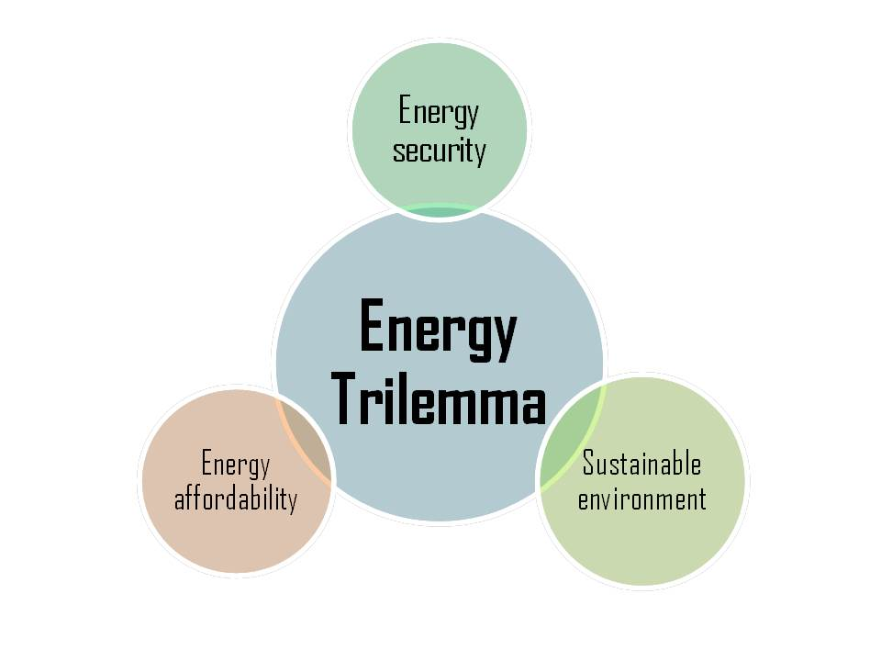
National and global energy resources
Security and reliability of energy supplies
In the UK a mix of energy supplies are used so should one supply become unavailable, others can be used without disruption to supplies.
Some energy sources are more reliable than others. Coal, oil, gas and nuclear are reliable sources as they can supply a continuous flow of electricity.
The Energy mix
Electricity from wind turbines relies on the wind blowing, solar power does not work at night and hydro-electric requires a continuous supply of water. These are considered unreliable sources.

Slide 67
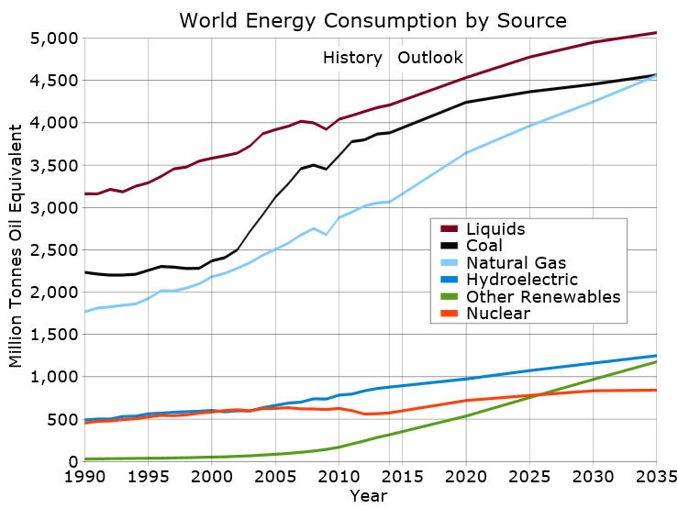
National and Global energy resources – Trends in energy use
World energy use trends and predictions
The total amount of energy used in the world is increasing as the population increases and each person is using more energy.
Renewable energies only make up around 20% of total energy consumption and this trend is unlikely to change until after 2035.
Future world agreements on emissions are likely to determine the trend of using fossil fuels.
As reserves of coal, oil and gas dwindle, an increase in the use of renewable energies is likely.

Slide 68
QuestionIT!
National and Global Energy resources

Slide 69
  National and Global Energy resources – QuestionIT
What is a fossil fuel?
2. Copy and complete the table below by ticking the correct box for
each energy source.
3. What is a renewable energy source?
Energy source | Renewable | Non-renewable
Bio-fuels
Oil
Nuclear
Hydro-electricity
Wind turbines
Coal
Solar power
Wave energy
Natural gas

Slide 70
  National and Global Energy resources – QuestionIT
4. Why are fossil fuels considered to be a more reliable energy
resource than renewable energy resources?
5. Despite a large investment by the UK government in wind power,
the amount of fossil fuel used has not seen a decline. Give a
possible explanation for this.
6. The UK government is committed to investing in a "blend" of energy
supply types to provide the UK’s energy needs for the next 100
years. Give an advantage of this rather than using just coal.

Slide 71
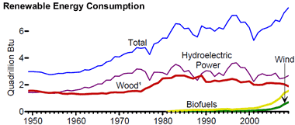
  National and Global Energy resources – QuestionIT
7. The graph shows the world use of renewable energies over the past sixty years.
a. Why has the use of wood increased very little over this time?
b. A lot of money has been invested in wind turbines. Why does this energy source not produce as much as any other renewable resource?

Slide 72
  National and Global Energy resources – QuestionIT
8. Copy and complete the table to give energy sources that could
be used in each situation.
9. Describe how human activities have contributed to the greenhouse
effect?
Energy use | Energy source 1 | Energy source 2
Running a car
Producing electricity
Heating the home
Powering a train

Slide 73
  National and Global Energy resources – QuestionIT
10. Explain how burning coal in power stations contributes to global
warming.
11. Describe two problems associated with the storage of waste from
nuclear power stations.
12. State two reasons why people might object to having a wind farm
built close to their homes.

Slide 74
AnswerIT!
National and Global Energy resources

Slide 75
  National and Global Energy resources – AnswerIT
What is a fossil fuel? A fuel formed in the geological past from the remains of living organisms.
2. Copy and complete the table below by ticking the correct box for
each energy source.
3. What is a renewable energy source?
An energy source that can be replenished as it is used.
Energy source | Renewable | Non-renewable
Bio-fuels
Oil
Nuclear
Hydro-electricity
Wind turbines
Coal
Solar power
Wave energy
Natural gas

Slide 76
  National and Global Energy resources – AnswerIT
4. Why are fossil fuels considered to be a more reliable energy
resource than renewable energy sources?
Produce a consistent energy supply with no gaps in energy delivery.
5. Despite a large investment by the UK government in wind power,
the amount of fossil fuel used has not seen a decline. Give a
possible explanation for this.
UK is using more energy and wind power can not meet this rise in
demand.
6. The UK government is committed to investing in a "blend" of energy
supply types to provide the UK’s energy needs for the next 100
years. Give an advantage of this rather than using just coal.
Evens out any variations in supply or cost of the energy source.
Using only coal, if supplies stopped or the cost went up greatly,
this would have a great impact on the consumer.

Slide 77
  National and Global Energy resources – AnswerIT
7. The graph shows the world use of renewable energies over the past sixty years.
a. Why has the use of wood increased very little over this time?
Limited supplies of wood and it takes a long time to grow new supplies. Also, pressure and legislation to prevent many trees from being cut down.
b. A lot of money has been invested in wind turbines. Why does this energy source not produce as much as any other renewable resource?
Each wind turbine only produces a small amount of electricity and not enough have been installed to match production from other renewable resources.

Slide 78
  National and Global Energy resources – AnswerIT
8. Copy and complete the table to give energy sources that could
be used in each situation.
9. Describe how human activities have contributed to the greenhouse
effect.?
Burning fossil fuels for heating, transport and industry has led to a
build up of carbon dioxide in the atmosphere (along with other
greenhouse gases).
Energy use | Energy source 1 | Energy source 2
Running a car | Petrol, Diesel, LPG | Any electricity producing source
Producing electricity | Coal, oil, gas | Renewable source
Heating the home | Coal, gas, wood | Any electricity producing source
Powering a train | Coal, Diesel, oil | Any electricity producing source

Slide 79
  National and Global Energy resources – AnswerIT
10. Explain how burning coal in power stations contributes to global
warming.
Carbon dioxide produced. Carbon dioxide absorbs and reflects
infrared radiation leading to additional warming.
11. Describe two problems associated with the storage of waste from
nuclear power stations.
Waste is radioactive can cause cells to mutate.
Radioactivity lasts for thousands of yeas so needs long term
storage.
12. State two reasons why people might object to having a wind farm
built close to their homes.
Considered unsightly by some. Can be noisy.
Disruption whilst installing and maintaining.
Produce little energy for their environmental impact.

